Slide 1
Welsh Athletics Limited
2024 Annual General Meeting
Welcome, the meeting will begin shortly
Please take a moment to note the following:
Please change your name displayed in Zoom to include your club name.
Use the ‘Chat’ to ask a question
Please remain on mute until invited to speak
NB This meeting will be recorded to help prepare written meeting minutes.
Then click here
Right click here
Open the Chat

Slide 2
Annual General Meeting
Welsh Athletics Limited
26th October 2024

Slide 3
Appointment of Scrutineers
In person:
Chris Moss
Andrew Thomas
Online:
Elle Cartlidge

Slide 4
Report of the Bord of Directors
James Williams (CEO)

Slide 5
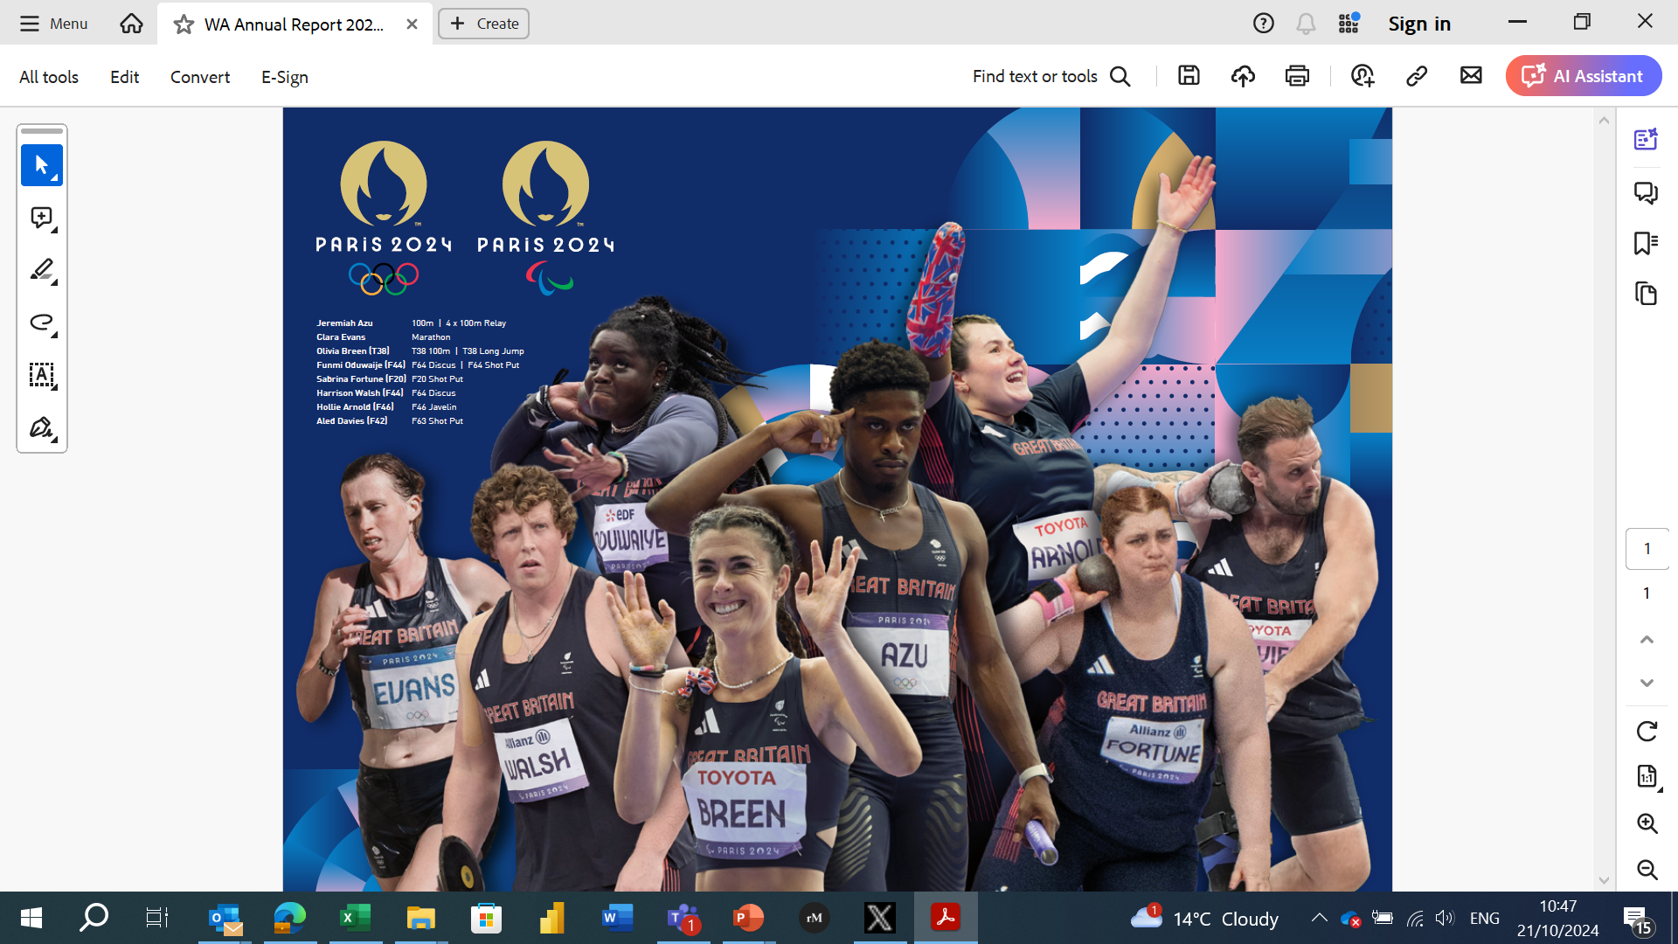

Slide 6
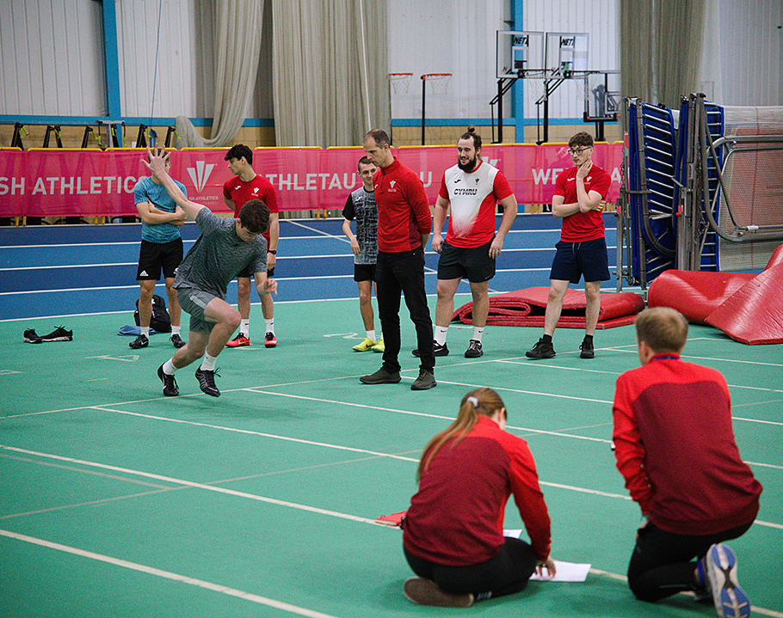
National Development Programme
Annual Programme of Activities
58 athletes, 30 coaches engaged
11 contact points
Guest Speakers – Colin Jackson, Jeremiah Azu
Education workshops – UKAD
20 athletes attended a WWT camp
Fully integrated
Rolling testing and engagement programme
6 athletes at European U18’s

Slide 7
Development - Club Membership

Slide 8
Junior trends….

Slide 9
Coaches/Officials

Slide 10
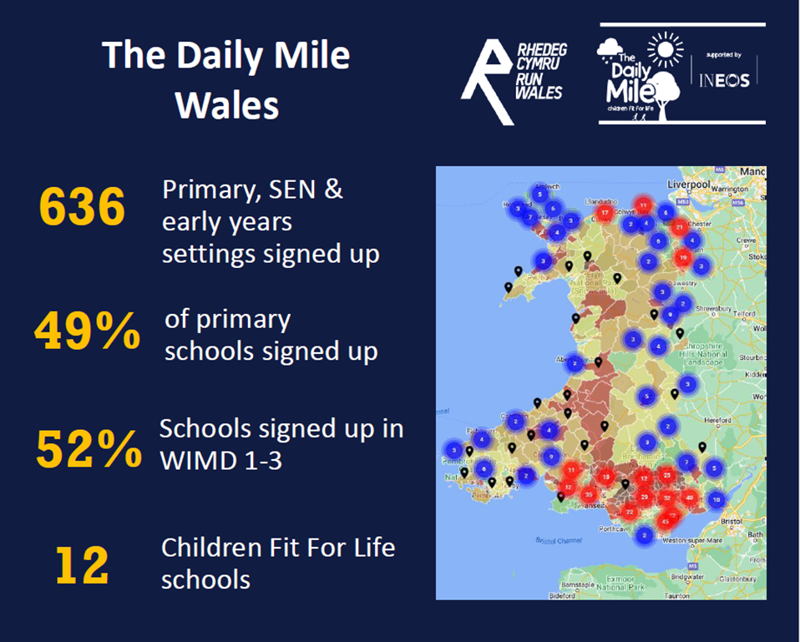
Participation

Slide 11
Facilities
Continue to work to safeguarding the future of the sport
Penlan Arena (Brecon): £180k Capital Grant – complete (end of the summer 2023).
Eirias Park (Conwy): £330k Local Authority investment - complete.
Cwrt Herbert (Neath): £225k Capital Grant – to be completed in 2025.
Haverfordwest (Pembrokeshire): £192k Capital Grant – to be completed in 2025.
NIAC (Cardiff): £53k Sport Wales / Capital Grant.
Ammanford (new facility): £800k (funded by Carmarthen Council)
Total of circa. £1.78m of investment
Will continue to look at all facilities across Wales and lobby for additional investment

Slide 12
Safeguarding
Continue to drive up standards
34 cases managed this year
L3 CPSU safeguarding in sport standard retained
Updated required training
T2L
Ann Craft Trust – Adults at Risk Training
Ann Craft Adult Assurance Framework submission (2nd ever NGB to submit)
Over 220 Club Welfare Officers Trained
Sector Leading
Zero Tolerance Approach

Slide 13
Competition
Welsh Junior League
Expanded North Wales offering
Event Specific
BMC partnered events
North Wales specific offering launched
Welsh Championships – record entries (Snr/U15, Road Relays)
Para integration – wheelchair Championships
Cardiff Cross Challenge – maintaining World Athletics label

Slide 14
Competition – looking ahead
Licensing Portal – Road/Multi Terrain now live
T&F, XC, Trail & Mountain
Race Directors Courses
Welsh Junior Champs – new date in June
Pilot – Throws League
Jumps specific series – Swansea
Further develop events in North Wales
Split Junior and Senior Road Relays – reflecting string growth
Empower new competition providers
British U23 Trials – within Welsh Senior Championships
British 5km Road Running Champs – within Podium 5k (Aug 25)

Slide 15
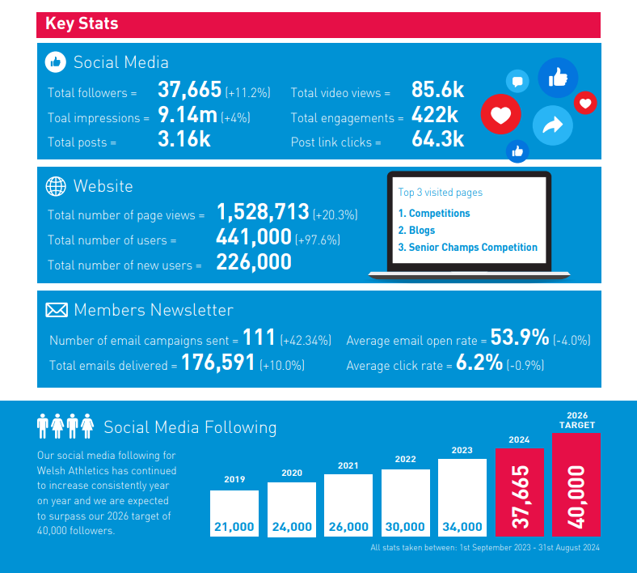
Communication & Marketing

Slide 16
Corporate Services
Staff Wellbeing & Culture
10% improvement in staff happiness relating to work/life balance through annual staff engagement survey
Mind Partnership – workshops on improving mental health
Refreshing organisational values and behaviors
Updated staff wellness assistance programme
Staff recruitment & retention
100% of roles recruited to date
Positive retention (1 departure)
Improved Maternity provision
Staff CPD and development focus
System Development
Improving internal processes (new systems and technology)
Focus on efficiency (finance and procedural)

Slide 17
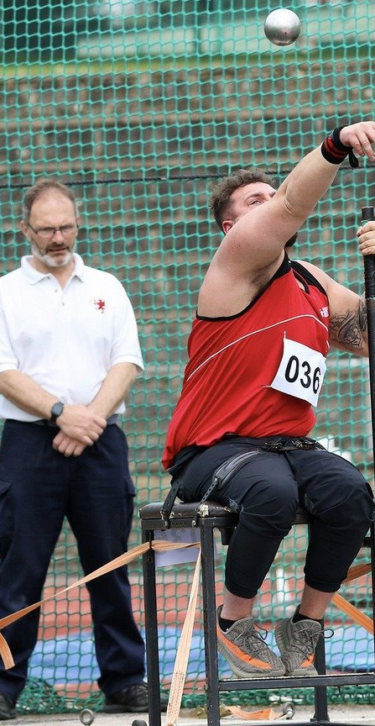
Looking Ahead
Continue to minimise dependency on Sport Wales funding
joint commercial agreement with UKA/HCAF
Empower the membership – competitions, innovation
Coach & Officials Development
Support modernisation of clubs
Continue to embed para-athletics, InSport Gold accreditation
Champion our sport with Welsh Govt & Key stakeholders
Navigate a challenging financial climate
Drive and advocate values and behaviours

Slide 18
And finally...
Thank you to our clubs, groups, coaches, officials,
volunteers, parents, athletes, directors & staff

Slide 19
3. Financial Report
James Williams - CEO

Slide 20
4. General Council Report
Lynne Brier - Chair, General Council

Slide 21
5. Appointment of Accountants
To appoint O’Brien and Partners as accountants for the ensuing year and authorise the Board to fix their remuneration.
HSJ Accountants Limited to continue as external financial auditors for the ensuing year with their remuneration fixed by the Board.

Slide 22
6. Appointment of Patrons
6.1 To re-appoint Lynn Davies CBE as a Patron of the company
6.2 To re-appoint Colin Jackson CBE as a Patron of the company

Slide 23
7. Appointment of the following positions
7.1 Members of the Awards & Heritage Panel

Slide 24
11. Notice of Motion
11.1 To Merge the two Awards panels and create an Awards and Heritage panel

Slide 25
7. Appointment of the following positions
7.2 Honorary President of Welsh Athletics – Graham Finlayson (re-election)
7.3 Vice President of Welsh Athletics – Ian Griffiths (to extend term by 1 year)

Slide 26
8. Appointment of Delegates to organisations on which the Company is entitled to be represented
8.1 To appoint one delegate to the Commonwealth Games Council for Wales, Executive Committee
– nominated, James Williams
8.2 To appoint three delegates to the Commonwealth Games
– nominated, James Williams, Steve Perks & Chris Type
8.3 To appoint one delegate to the Welsh Sport Association
– nominated, James Williams

Slide 27
9. Determination of annual registration and affiliation fees (for 2022/2023)
9.1 Proposal to increase the Club affiliation fee
9.2 Proposal to increase the Athlete registration fee

Slide 28
11. Notice of Motion
11.2 To amend the club affiliation fee structure

Slide 29
10. Consideration of the report of the Service Awards Panel
10.1 To receive and accept the recommendations for the appointment of Life Members of Welsh Athletics
10.2 To receive and accept the recommendations for the
Meritorious Award
10.3 To receive and accept the recommendations for the Award of Honour
10.4 To receive and accept the recommendations for the Athlete Achievement Award

Slide 30
Life Members

Slide 31
Award of Honour

Slide 32
Meritorious Award

Slide 33
Athlete Achievement Award

Slide 34
12. Date and Venue of 2025 General Meeting
Proposed
Saturday 25th October 2025
venue to be confirmed

Slide 35
Thank You
Diolch yn fawr

